Slide 1



A Conversational AI
LSTM Based Tamil Chat-bot for Academic Information System
By Kishore Kumar L, Karthik P, Venkateshwar S, Sundarambal B, Ponnusamy R

Slide 2
Problem statement
In current days, it has become a common practice for organizations and institutions to have a virtual assistant (chat-bot) to help users navigate their website, find what they’re looking for, access the features that they desire and so on.
But due to a variety of factors, a lot of people in our country and our state have difficulties overcoming the language barrier.
Since most of these virtual assistants are built to respond in English, they are unable to assist those that do not understand the language.
As such, we have created a conversational AI that will display academic information about our college in our native language, தமிழ்.

Slide 3
What is a conversational AI ?
Conversational AI refers to a type of artificial intelligence designed to help software understand and interact with people in the most intuitive way possible, (ie) via natural language.
In this project, we have implemented conversational AI to provide academic information about our institution in the தமிழ் language using RASA.

Slide 4
What is RASA?
Rasa is a framework for developing AI powered, industrial grade chatbots. It's incredibly powerful, and is used by developers worldwide to create chatbots and contextual assistants.
Basically, it is a library with predefined models and pipelines, specific for creating chatbots that make the process simplified.
It also makes it easy to integrate it with the website for functioning.

Slide 5
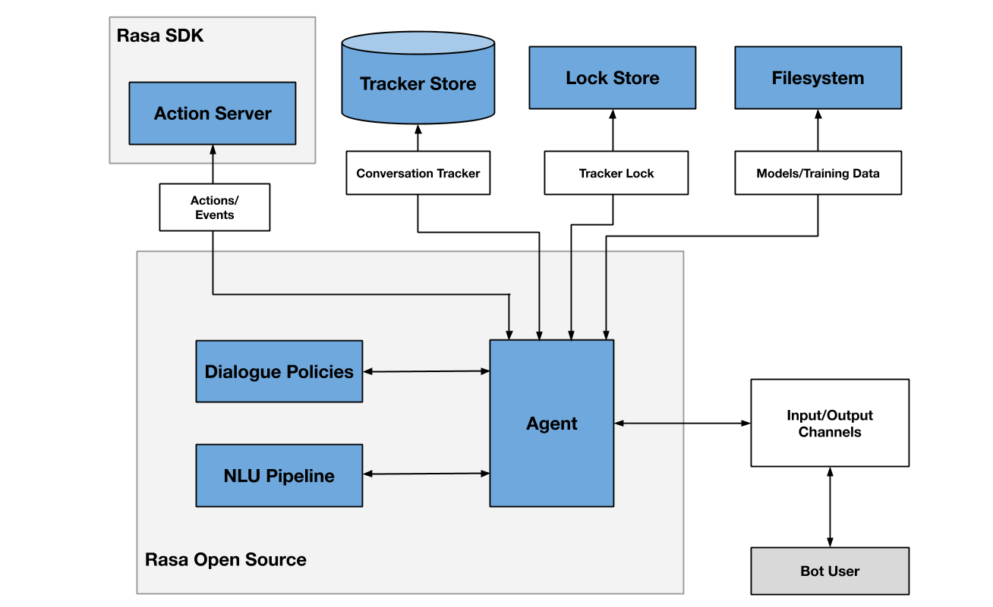
Architecture

Slide 6
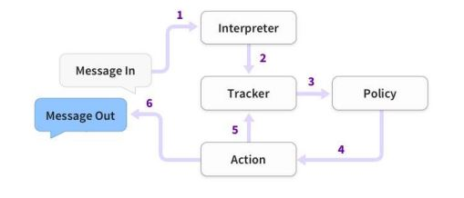
Working
The user’s message is received by the interpreter, which translates it into a dictionary of text, intents and all other entities.
These are then forwarded to the tracker which keeps track of the conversation status. It gives out the current status to the policy.
The tracker then co-ordinates with the policy and determines the appropriate response to be given out , which is the “action” here.
The user responds to the message from the bot and the cycle continues.

Slide 7
Rasa has two main components:
Rasa NLU (Natural Language Understanding): Rasa NLU is an open-source natural language processing tool for intent classification (decides what the user is asking), extraction of the entity from the bot in the form of structured data and helps the chatbot understand what user is saying.
Rasa Core: a chatbot framework with machine learning-based dialogue management which takes the structured input from the NLU and predicts the next best action using a probabilistic model like LSTM neural network rather than if/else statement. Underneath the hood, it also uses reinforcement learning to improve the prediction of the next best action.
Core models learn from real conversational data in the form of training “stories”. A story is a real conversation between a user and an assistant.

Slide 8


Under the hood
Regex
featurizer
Lexical syntactic featurizer
ENTITY SYNONYM MAPPER
RESPONSE SELECTOR
White space tokenizer

Slide 9
White Space Tokenizer:
Tokenizer using whitespaces as a separator
Creates a token for every whitespace separated character sequence.
Regex Featurizer:
Creates a vector representation of user message using regular expressions.
Lexical Syntactic Featurizer:
Creates lexical and syntactic features for a user message to support entity extraction.

Slide 10
Entity Synonym Mapper:
Maps synonymous entity values to the same value.
Entities are structured pieces of information inside a user message
Synonyms map extracted entities to a value other than the literal text extracted
Response Selector:
The response selector embeds user inputs and candidate response into the same space.
Supervised embeddings are trained by maximizing similarity between them.

Slide 11
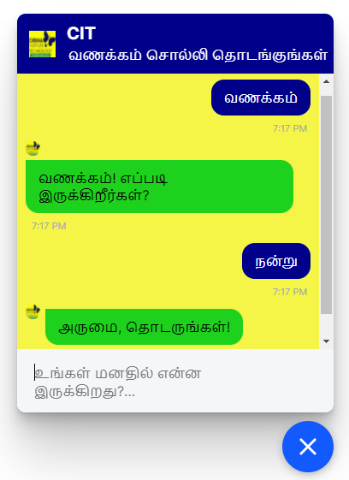
Graphical User Interface
The GUI is implemented using JavaScript.
The chatbot is displayed as a container in the corner of the screen activated by a button.
The messages are entered by the user in the text box provided.
The responses from the bot are displayed inside the container.
RASA also provides GUI integration support via various designated tools which can be accessed by linking them in the script code.

Slide 12

Thank you,
Our guide – Ponnusamy R
International Forum for Information Technology in Tamil
The audience

